Slide 1

Peter Norvig, “The Gettysburg PowerPoint Presentation,” October 12, 2011, norvig.com/Gettysburg/.
.

Slide 2
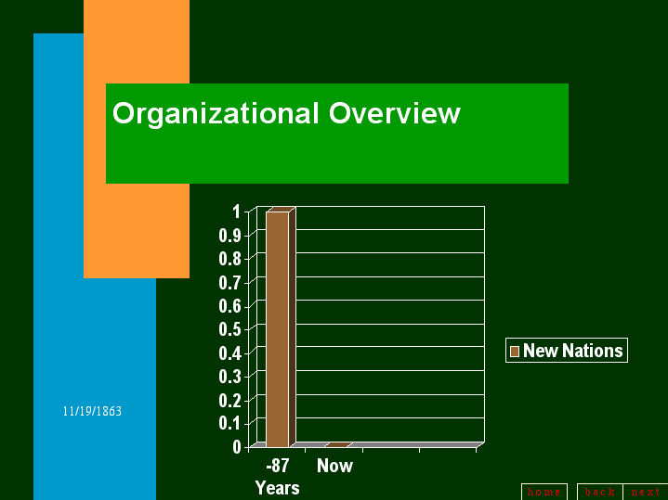
Peter Norvig, “The Gettysburg PowerPoint Presentation,” October 12, 2011, norvig.com/Gettysburg/.
.

Slide 3
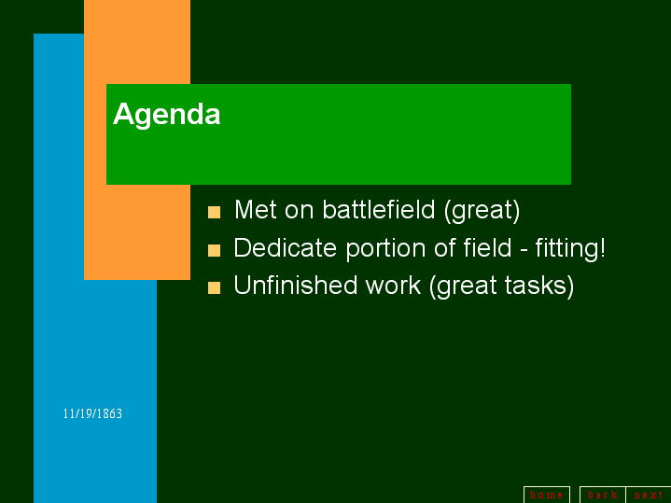
Peter Norvig, “The Gettysburg PowerPoint Presentation,” October 12, 2011, norvig.com/Gettysburg/.
.

Slide 4
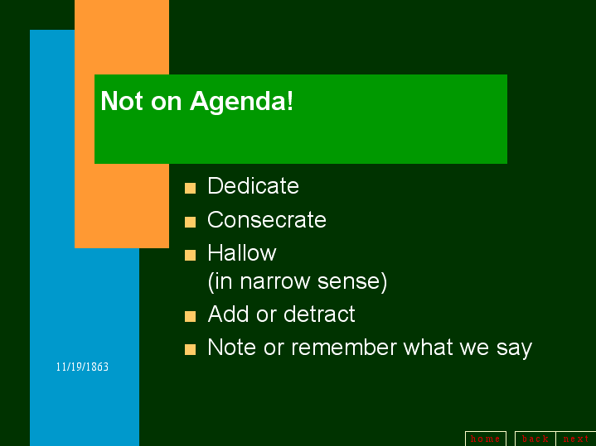
Peter Norvig, “The Gettysburg PowerPoint Presentation,” October 12, 2011, norvig.com/Gettysburg/.
.

Slide 5

Peter Norvig, “The Gettysburg PowerPoint Presentation,” October 12, 2011, norvig.com/Gettysburg/.
.

Slide 6
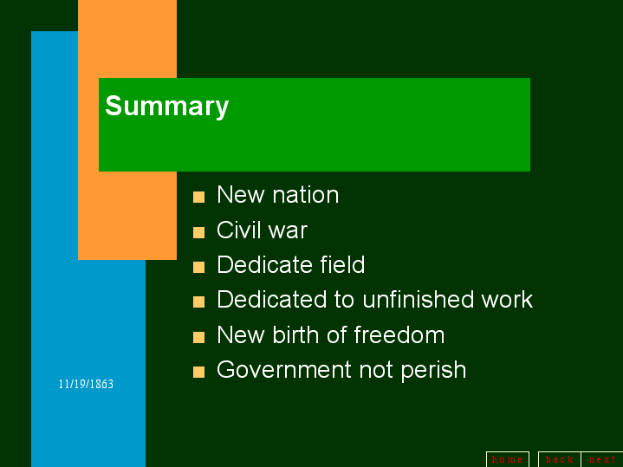
Peter Norvig, “The Gettysburg PowerPoint Presentation,” October 12, 2011, norvig.com/Gettysburg/.
.

Slide 7
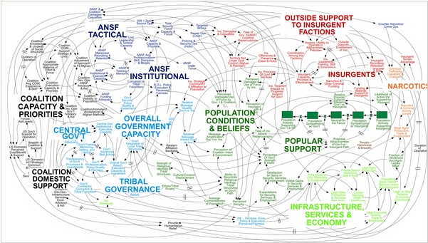
A military PowerPoint diagram meant to portray the complexity of American strategy in Afghanistan. Source: Elisabeth Bumiller, “We Have Met the Enemy and He is PowerPoint,” New York Times, April 26, 2010. We Have Met the Enemy and He Is PowerPoint.

Slide 8
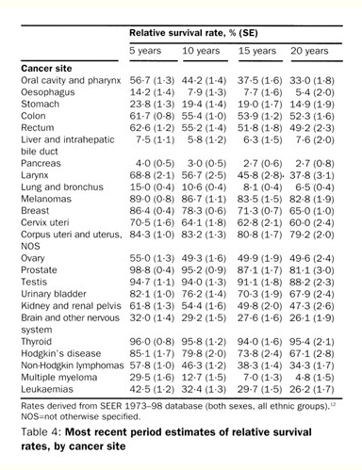
Hermann Brenner, "Long-term survival rates of cancer patients achieved by the end of the 20th century: a period analysis," The Lancet, 360 (October 12, 2002), pp. 1131-1135.

Slide 9
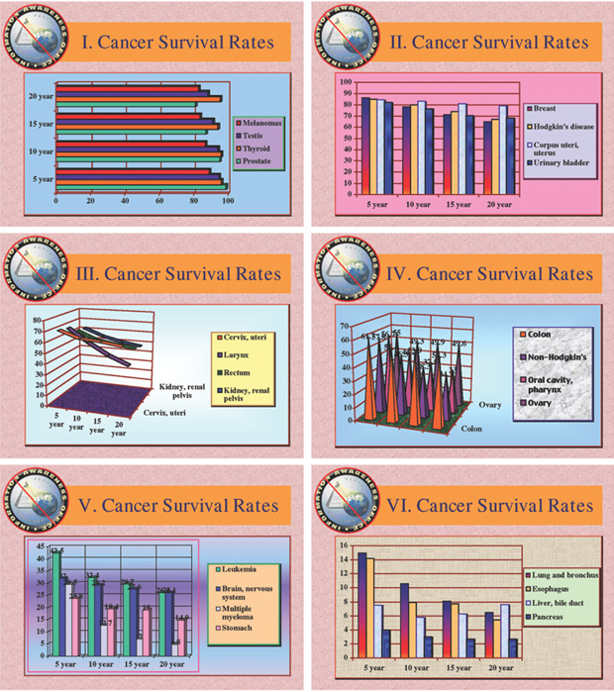
Cancer survival rates chart from the Information Awareness Office of Defense Advanced Research Projects Agency (DARPA), 2002. Source: Edward Tufte, “The Cognitive Style of PowerPoint,” Beautiful Evidence (Cheshire, CT: Graphics Press LLC, 2006) p. 175.

Slide 10
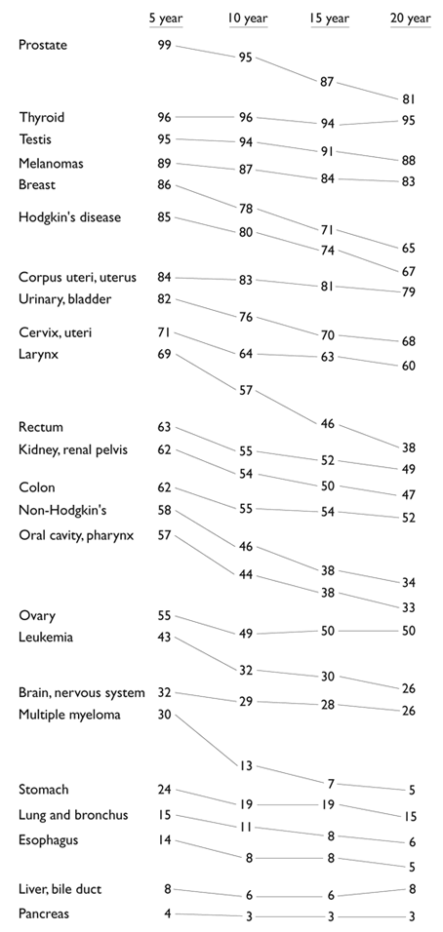
Revised cancer survival rates chart by Edward Tufte. Source: Edward Tufte, “The Cognitive Style of PowerPoint,” Beautiful Evidence (Cheshire, CT: Graphics Press LLC, 2006) p. 176.

Slide 11
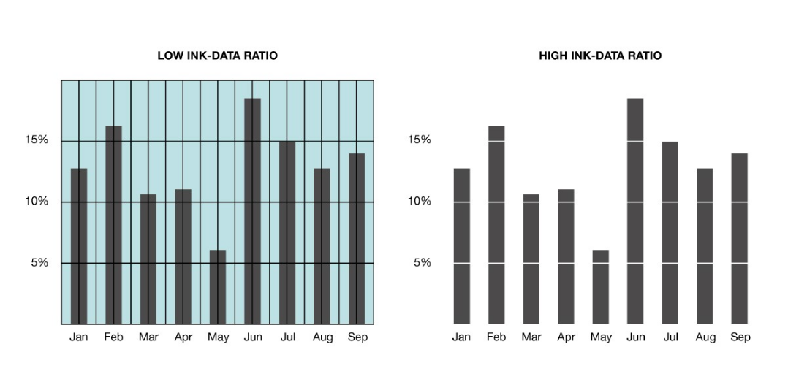
WinWire Technologies, “Principles for Creating Effective Data Visualization,” https://www.winwire.com/data-visualization.
.

Slide 12
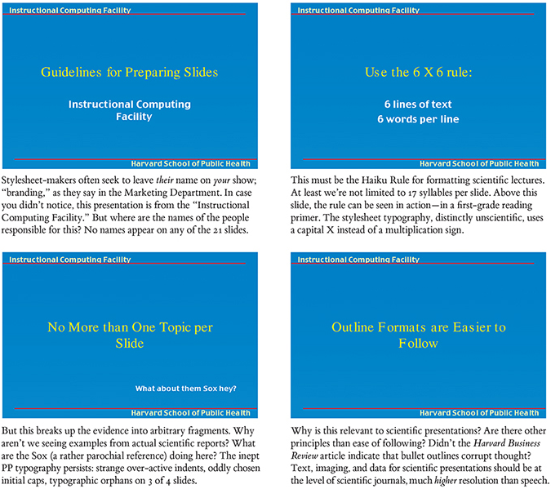
Slides prepared by the Instruction Computing Facility at the Harvard School of Public Health. Source: Edward Tufte, “The Cognitive Style of PowerPoint,” Beautiful Evidence (Cheshire, CT: Graphics Press LLC, 2006) p. 177.

Slide 13
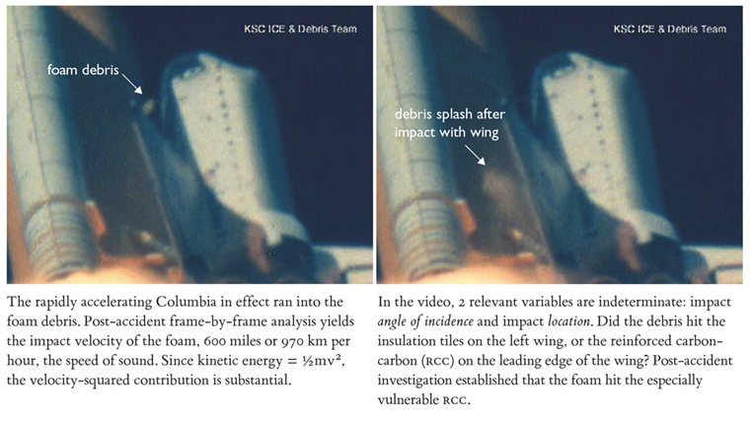
Photos of the debris impact on the Columbia space shuttle’s wing shortly after launch. Source: Edward Tufte, “PowerPoint Does Rocket Science: Assessing the Quality and Credibility of Technical Reports,” Beautiful Evidence (Cheshire, CT: Graphics Press LLC, 2006) p. 162. https://www.edwardtufte.com/bboard/q-and-a-fetch-msg?msg_id=0001yB&topic_id=1&topic=Ask+E%2eT%2e.

Slide 14
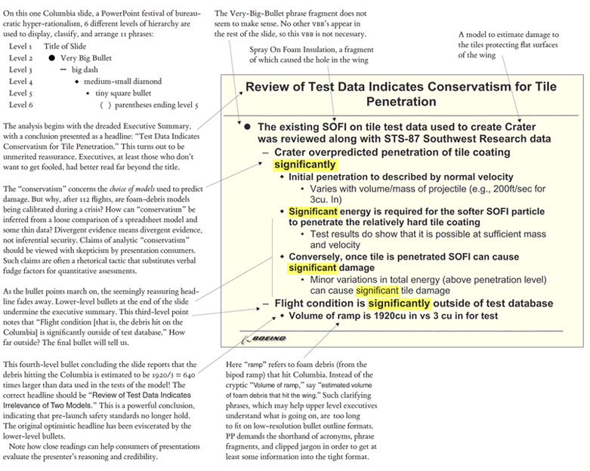
Edward Tufte’s analysis of a Boeing PowerPoint slide for the Columbia Accident Investigation Board. Source: Edward Tufte, “PowerPoint Does Rocket Science: Assessing the Quality and Credibility of Technical Reports,” Beautiful Evidence (Cheshire, CT: Graphics Press LLC, 2006) p. 164. https://www.edwardtufte.com/bboard/q-and-a-fetch-msg?msg_id=0001yB&topic_id=1&topic=Ask+E%2eT%2e.

Slide 15
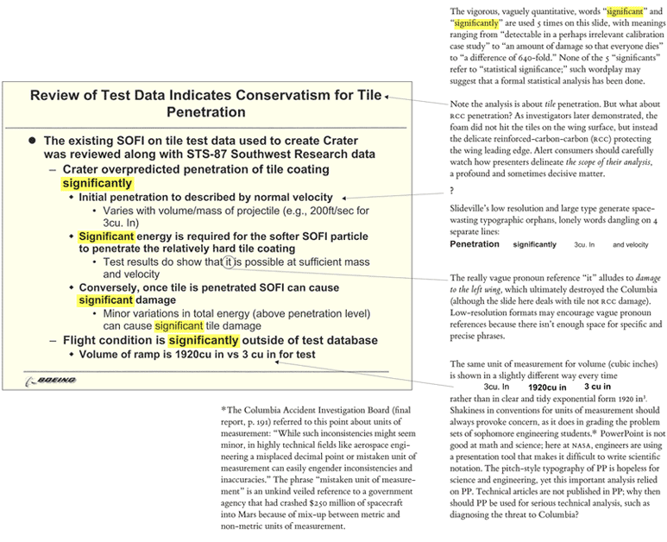
Edward Tufte’s analysis of a Boeing PowerPoint slide for the Columbia Accident Investigation Board. Source: Edward Tufte, “PowerPoint Does Rocket Science: Assessing the Quality and Credibility of Technical Reports,” Beautiful Evidence (Cheshire, CT: Graphics Press LLC, 2006) p. 165. https://www.edwardtufte.com/bboard/q-and-a-fetch-msg?msg_id=0001yB&topic_id=1&topic=Ask+E%2eT%2e.

Slide 16
Works Cited in the Oral Script*
Bezos, Jeff. "Amazon's Annual Report." sec.gov/Archives/edgar/data/1018724/000119312518121161/d456916dex991.htm. Letter to shareholders, 2018. Web. 18 Jul. 2019.
Bumiller, Elisabeth. "We Have Met the Enemy and He Is PowerPoint." nytimes.com/2010/04/27/world/27powerpoint.html?hp. New York Times, 26 Apr. 2010. Web. 18 Jul 2019.
Columbia Accident Investigation Board. "The Accident's Organizational Causes." s3.amazonaws.com/akamai.netstorage/anon.nasa-global/CAIB/CAIB_lowres_chapter7.pdf. National Aeronautics and Space Administration, August 2003. Vol. 1, p. 191. Web. 18 Jul. 2019.
Isaacson, Walter. Steve Jobs. Simon & Schuster (U.S.), 2015. p. 337. Print.
Norvig, Peter. "The Gettysburg PowerPoint Presentation." norvig.com/Gettysburg/. 12 Oct. 2011. Web. 18 Jul. 2019.
Orwell, George. Politics and the English Language. London: Horizon, GB, 1946. Print.
"Using PowerPoint and Alternatives Successfully." courses.lumenlearning.com/boundless-communications/chapter/using-powerpoint-and-alternatives-successfully/. 21 Dec. 2012. Web. 18 Jul. 2019.
*This list does not contain the script’s visual aid references. See the figure captions in the printed handout for source information on those references.

